Slide 1
Javadoc

Slide 2
Javadoc
Java Documentation
Robust documentation system and API
Part of the reason Java took off
Made up from actual comments in code
Generated into webpages using Javadoc tool
For now: you will focus on reading
The important part of reading
“small picture”
or
What can I do

Slide 3
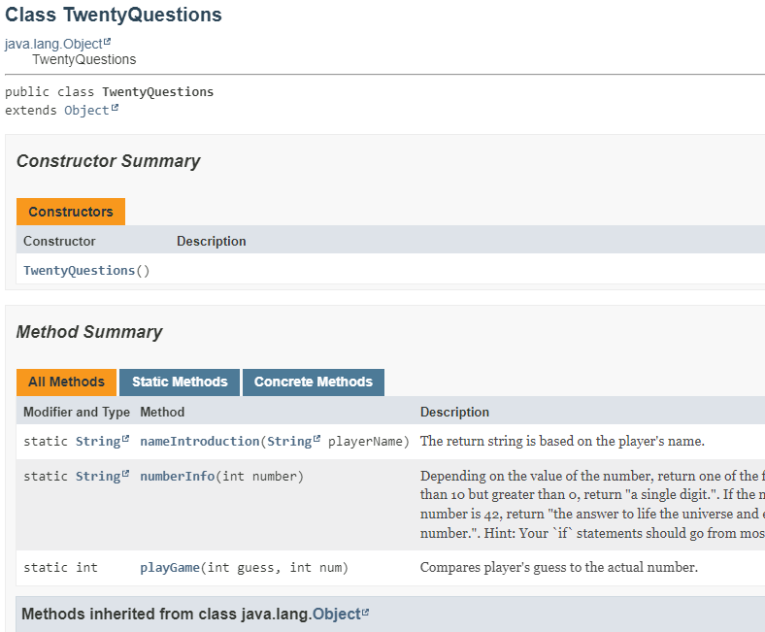
In labs – Small Picture
A lot we ignore for now!
Look at method summary
Gives signature
Static or not
Parameters
Return type
Name
Click on method name
a single sentence – often a short description

Slide 4
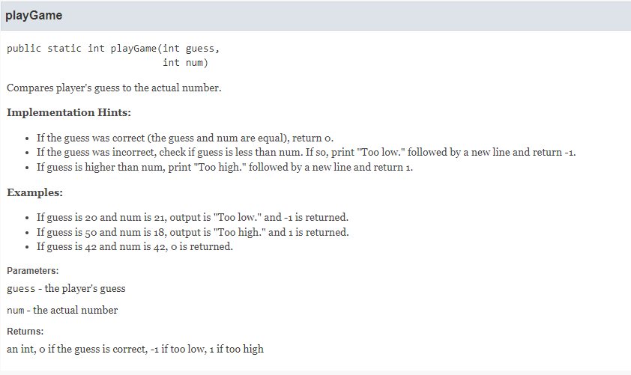
Single Method (the small)
Gives exact method signature!
Copy it and paste it, add curly brackets..
Gives hints that we put in for building the method / what you need to do
Suggestion: use comments and pseudocode based on those hints!
Parameters
Gives you what to expect in them
Returns
What the method should return for an answer
May also have “See Also”

Slide 5
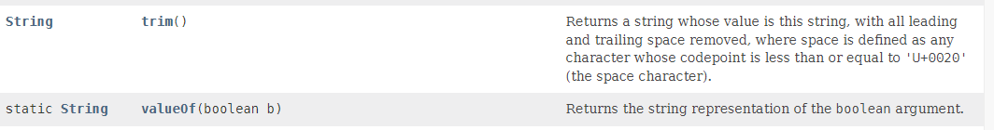
API / SDK Reference (the big)
String is a class someone wrote in Java
Full Javadoc
Overwhelming at first.. But
Just look at the methods
This gives you ‘functionality’
String clientInput = " hello ";
clientInput = clientInput.trim();
// client input is now "hello"
boolean checkbox = true;
String print = String.valueOf(checkbox);
// sets String "true" to variable print

Slide 6
Overall
Another tool to use
We will use it *a lot* in labs
Your method ‘specifications’ will be in the javadoc!
You will want to use it when working with Java Libraries
String
A lot in there haven’t covered
Don’t try to understand it all

